Slide 1




Project on : Crypto Currencies

Slide 2

CONTENTS
Introduction
Objective
Web scraping
EDA
Visualizations
Conclusion

Slide 3
Introduction
Cryptocurrencies are digital or virtual currencies that use cryptography for security, making them decentralized and independent of central banks. The most well-known cryptocurrency, Bitcoin, was introduced in 2009, paving the way for thousands of other digital assets like Ethereum, Ripple, and more.
Some key features include Decentralization, Block chain technology & Global Reach.

Slide 4
Objective
Analyze historical prices and trading volumes of major cryptocurrencies.
Identify price trends and patterns over time.
Explore correlations between different cryptocurrencies.
Observe the impact of market trade and other parameters.
Visualize data for deeper insights.

Slide 5
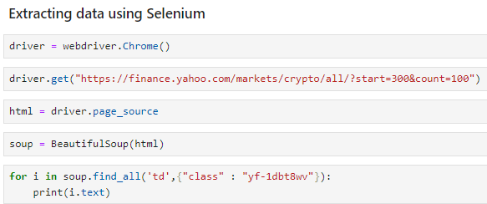
Web scraping
Website Used : finance.yahoo.com
Primary source for extracting financial data.
Tools Used :
Selenium : Creates a replica of an existing Chrome page, enabling navigation and data extraction from non-paginated websites.
Beautiful Soup : Parses and prettifies HTML into readable text format.
Regex : Utilized for extracting specific data using universal pattern matching.
For Loop Function : Iterates through the data to extract the required details for each column.

Slide 6
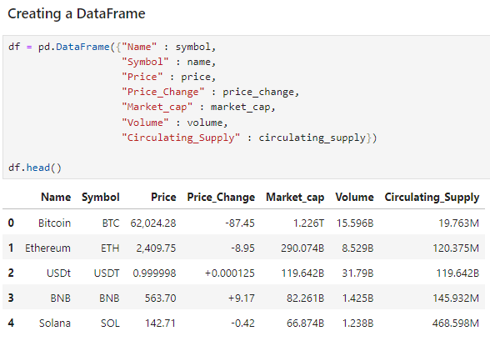
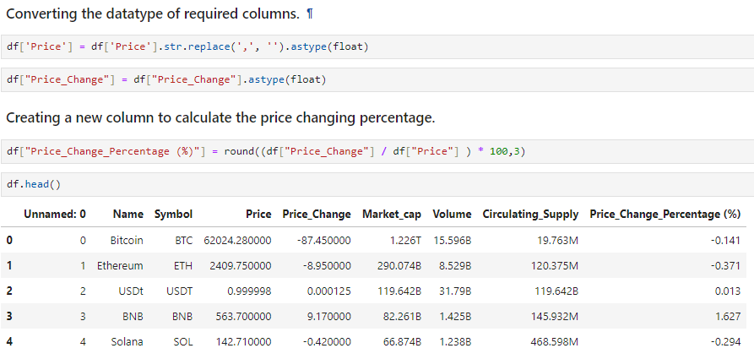
Exploratory data analysis
Step 1 : Data Frame creation
Step 2 : New columns creation

Slide 7
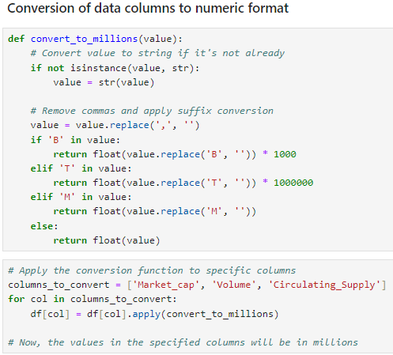
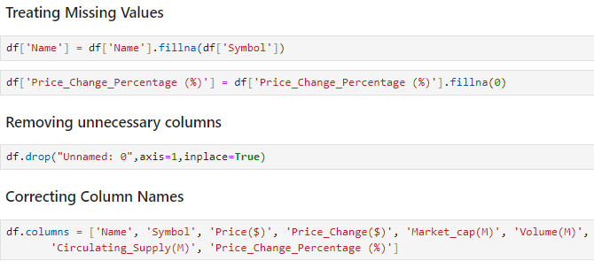
Exploratory data analysis
Step 3 : Data conversion
Step 4 : Data cleaning

Slide 8
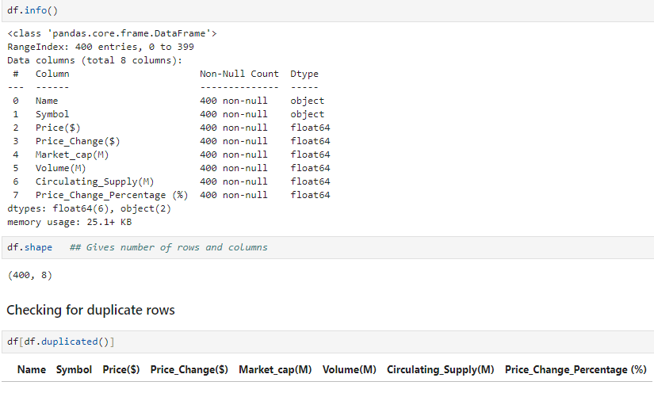
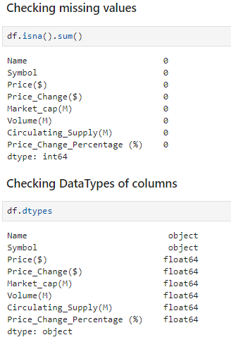
Exploratory data analysis
Step 5 : Checking duplicates
Step 6 : Checking missing values & dtypes

Slide 9
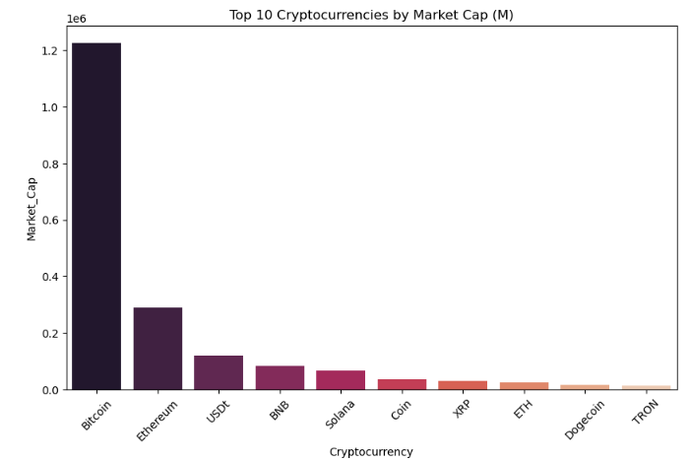
Visualizations
Bitcoin leads with a massive market cap, over 1.2 million.
Ethereum ranks second but significantly lower, around 0.2 million.
USDT, BNB, and Solana follow with smaller market caps.
XRP, ETH, Dogecoin, and TRON round out the list with much lower values.
Highlights the substantial gap between Bitcoin and other top cryptocurrencies.

Slide 10
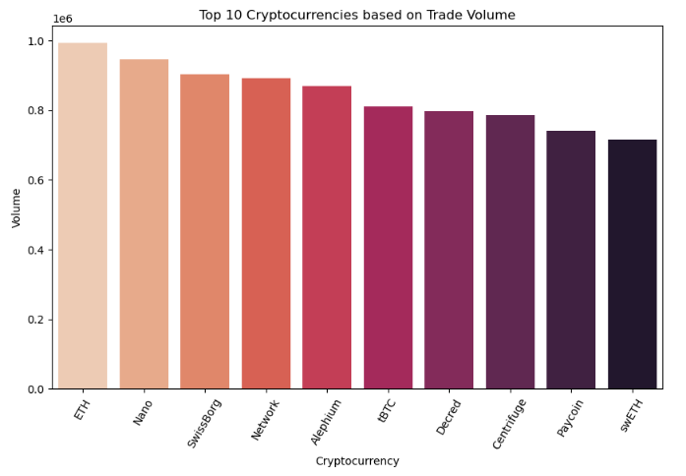
Ethereum leads in trade volume, dominating the market.
Nano,IssBorg (privacy-focused) and Network (platform-oriented) follow closely.
Bitcoin, despite its market dominance, falls behind in trade volume.
The top 10 showcases a diverse range of cryptocurrencies, spanning payments to decentralized finance.
This dynamic market drives growing adoption and fuels innovation in the crypto space.

Slide 11
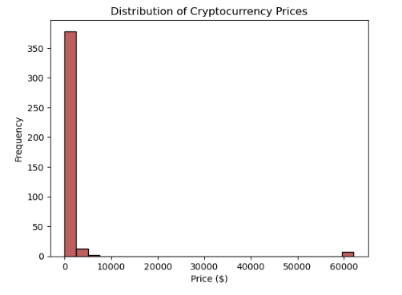
The histogram shows a right-skewed distribution of cryptocurrency prices, with most values below $10,000.
Prices cluster at lower levels, indicating a large concentration of low-priced cryptocurrencies.
Long tail of outliers represents a few high-priced cryptocurrencies.
Significant clustering around 0 suggests many cryptocurrencies hold very low or no value.

Slide 12
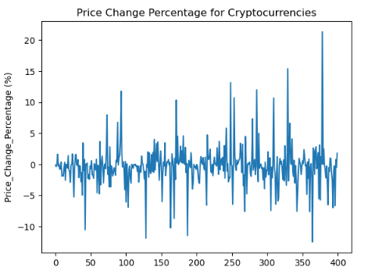
The chart shows high volatility in cryptocurrency price changes, with fluctuations ranging from -10% to over 20%.

Slide 13
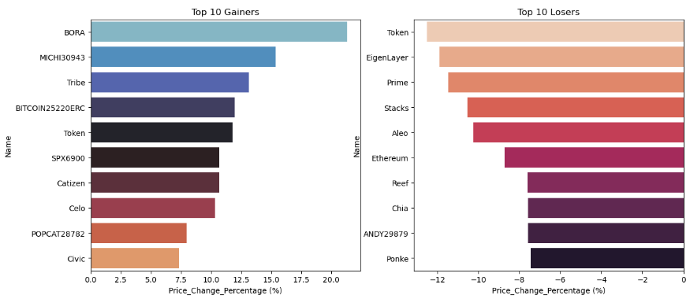
The graphs provide a snapshot of the top-performing and least-performing cryptocurrencies based on their price changes during a specific period

Slide 14
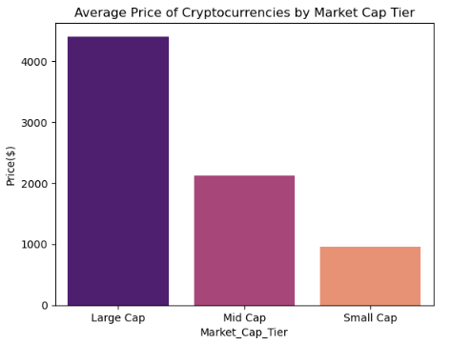
The bar graph shows that the average price of cryptocurrencies increases with their market capitalization tier.
Large Cap cryptocurrencies have the highest average price, followed by Mid Cap and Small Cap.

Slide 15
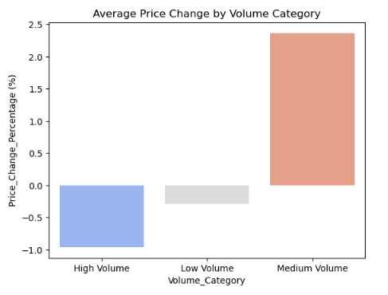
High volume cryptocurrencies display a negative average price change, indicating value loss over time.
Low volume cryptocurrencies have a slightly negative average price change, closer to zero.
Medium volume cryptocurrencies show a positive average price change, suggesting value gains.

Slide 16
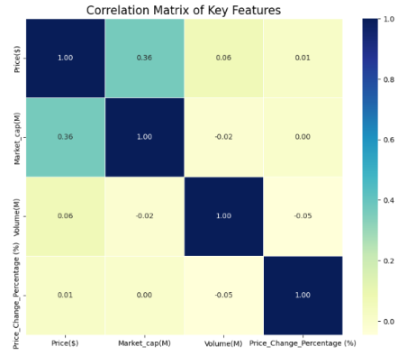
The correlation matrix reveals moderate positive correlations between price and market capitalization, while other variable pairs exhibit weak correlations.
These relationships are not substantial, indicating a lack of strong causal connections.

Slide 17
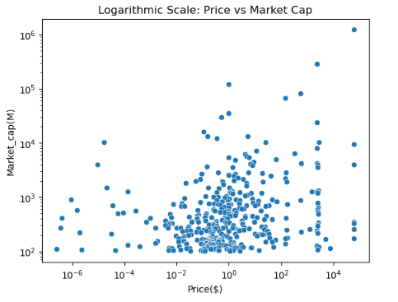
The scatter plot suggests a complex relationship between price and market cap for cryptocurrencies.
While there is no clear linear relationship, the clustering of data points and the presence of outliers indicate that there might be underlying patterns and factors influencing this relationship.

Slide 18
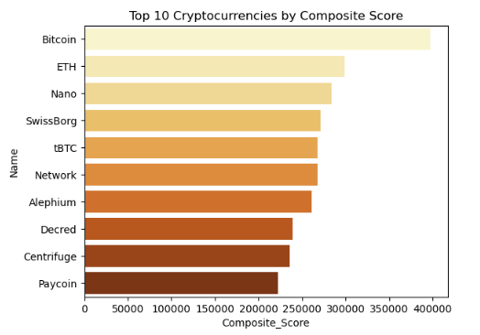
This chart ranks the top 10 cryptocurrencies by a Composite Score, which blends price (40%), market cap (30%), and trading volume (30%).
Bitcoin leads with the highest score, excelling in all three metrics.
Followed by Ethereum and Nano & all other coins.

Slide 19
Key insights
Bitcoin dominates the market, followed by Ethereum.
High price volatility presents both opportunities and risks.
Market cap and price are generally correlated, but exceptions exist.
Trading volume influences price movements, but doesn't guarantee gains.
Most cryptocurrencies have low prices, with a few high-priced outliers.
Performance varies widely, emphasizing the need for diversification.

Slide 20
Conclusion
The cryptocurrency market is a dynamic and complex ecosystem, offering both opportunities and challenges.
Investors must carefully assess the risks and rewards before investing and stay informed about the latest market trends and developments

Slide 21


Slide 22
THANK YOU
Mereddy Sai Prakash Reddy
Vitla Veera Bhavani
Teegala Bhargavi

